Slide 1
LWC Training
Communicate with
Events
MAY 09, 2019
Day 3: Communicate with Events

Slide 2
Today’s Objectives
agenda
Introduction
Create and Dispatch Events
Handle Events
Configure Event Propagation
Communicate between Components
Event Best Practices
Hands on Challenge

Slide 3
Introduction

Slide 4
Introduction
introduction
Events in Lightning web components are built on DOM Events, a collection of APIs and objects available in every browser.
The DOM events system is a programming design pattern that includes these elements.
An event name, called a type
A configuration to initialize the event
A JavaScript object that emits the event
Use events to communicate up the component containment hierarchy. For example, a child component, c-todo-item, dispatches an event to tell its parent, c-todo-app, that a user selected it.
Create and dispatch events in a component’s JavaScript class. To create an event, use the CustomEvent() constructor. To dispatch an event, call the EventTarget.dispatchEvent() method.
Naming Convention recommended by salesforce :
No uppercase letters
No spaces
Use underscores to separate words
To pass data up to a receiving component, set a detail property in the CustomEvent constructor
It’s a best practice either to send only primitives, or to copy data to a new object before adding it to the detail property. Copying the data to a new object ensures that you’re sending only the data you want, and that the receiver can’t mutate your data.

Slide 5
Create and Dispatch Events

Slide 6
Create and Dispatch Events
Create and dispatch events
To create an event, use the CustomEvent() constructor
To dispatch an event, call the EventTarget.dispatchEvent() method
The CustomEvent constructor has one required parameter, which is a string indicating the event type. As a component author, you name the event type when you create the event. You can use any string as your event type.
new CustomEvent(‘inptext’,{
detail:name
});
this.dispatchEvent(selectEvent);
Notes:
ASG – Would need to be ready by Juen for the certified to sell – 3 mo in certified to sell. To show it off at dreamforce 2019.
App exchange I splanned for the solution. If it’s just an asset then they want to review our architecture.
We don’t’ want this on the app exchange.
Approval is all of us, Chandu,. He delegated Subhojit to be our architect.
LWC v Aura – need to be able to regenerate the components with a future technology if needed. Kiran, is the look and feel different, how would that be done?
Security is not yet future proof
Vivek – security team – AERS design
Could we add Louisiana in the mix, to design not to break it in the future – master mapping exercise in the govCONNECT model – if you’re a state with x, here is how you would map to our roles
Let’s make conscious decisions together.
CO – you configure the call, and ti calls an interface, and the framework handles how to call the interface and the elments that are prepopulated.

Slide 7
Example
Create and dispatch events
Use the below eventsource.html code. In this code we have an input text field that will fire an event on onchange of the input text.
<template>
<lightning-card title="Event Source">
<div class="slds-m-around_medium">
<lightning-input name="textVal" label="Enter Text“ onchange={handleChange}></lightning-input>
</div>
</lightning-card>
</template>
Notes:
ASG – Would need to be ready by Juen for the certified to sell – 3 mo in certified to sell. To show it off at dreamforce 2019.
App exchange I splanned for the solution. If it’s just an asset then they want to review our architecture.
We don’t’ want this on the app exchange.
Approval is all of us, Chandu,. He delegated Subhojit to be our architect.
LWC v Aura – need to be able to regenerate the components with a future technology if needed. Kiran, is the look and feel different, how would that be done?
Security is not yet future proof
Vivek – security team – AERS design
Could we add Louisiana in the mix, to design not to break it in the future – master mapping exercise in the govCONNECT model – if you’re a state with x, here is how you would map to our roles
Let’s make conscious decisions together.
CO – you configure the call, and ti calls an interface, and the framework handles how to call the interface and the elments that are prepopulated.

Slide 8
Example - Continued..
Create and dispatch events
Use the below eventsource.js code and in this code, we have an handleChange function that will fire the event using the CustomEvent.
import {
LightningElement
} from 'lwc';
export default class Eventsource extends LightningElement {
handleChange(event) {
event.preventDefault();
const name = event.target.value;
const selectEvent = new CustomEvent('inptext', {
detail: name
});
this.dispatchEvent(selectEvent);
}
}
Notes:
ASG – Would need to be ready by Juen for the certified to sell – 3 mo in certified to sell. To show it off at dreamforce 2019.
App exchange I splanned for the solution. If it’s just an asset then they want to review our architecture.
We don’t’ want this on the app exchange.
Approval is all of us, Chandu,. He delegated Subhojit to be our architect.
LWC v Aura – need to be able to regenerate the components with a future technology if needed. Kiran, is the look and feel different, how would that be done?
Security is not yet future proof
Vivek – security team – AERS design
Could we add Louisiana in the mix, to design not to break it in the future – master mapping exercise in the govCONNECT model – if you’re a state with x, here is how you would map to our roles
Let’s make conscious decisions together.
CO – you configure the call, and ti calls an interface, and the framework handles how to call the interface and the elments that are prepopulated.

Slide 9
Example - Continued..
Create and dispatch events
Now create an event container component that will receive the events form the eventsource. create lightning web components using the below SFDX command.
Use the below eventcontainer.html code. To listen for events, use an HTML attribute with the syntax oneventtype Since our event type inptext, the listeners are oninptext and call the handler function on oninptext events as shown below.
<template>
<div class="slds-m-around_medium">
You Enter {valueInp}
<c-eventsource oninptext={handleSelect}></c-eventsource>
</div>
</template>
Notes:
ASG – Would need to be ready by Juen for the certified to sell – 3 mo in certified to sell. To show it off at dreamforce 2019.
App exchange I splanned for the solution. If it’s just an asset then they want to review our architecture.
We don’t’ want this on the app exchange.
Approval is all of us, Chandu,. He delegated Subhojit to be our architect.
LWC v Aura – need to be able to regenerate the components with a future technology if needed. Kiran, is the look and feel different, how would that be done?
Security is not yet future proof
Vivek – security team – AERS design
Could we add Louisiana in the mix, to design not to break it in the future – master mapping exercise in the govCONNECT model – if you’re a state with x, here is how you would map to our roles
Let’s make conscious decisions together.
CO – you configure the call, and ti calls an interface, and the framework handles how to call the interface and the elments that are prepopulated.

Slide 10
Example - Continued..
Create and dispatch events
Use the eventcontainer.js code. Receiving components access the data in the detail property in the event listener’s handler function.
import {
LightningElement,
track
} from 'lwc';
export default class Eventcontainer extends LightningElement {
@track valueInp;
handleSelect(event) {
const textVal = event.detail;
this.valueInp = textVal;
console.log('textVaal' + textVal);
}
}
Notes:
ASG – Would need to be ready by Juen for the certified to sell – 3 mo in certified to sell. To show it off at dreamforce 2019.
App exchange I splanned for the solution. If it’s just an asset then they want to review our architecture.
We don’t’ want this on the app exchange.
Approval is all of us, Chandu,. He delegated Subhojit to be our architect.
LWC v Aura – need to be able to regenerate the components with a future technology if needed. Kiran, is the look and feel different, how would that be done?
Security is not yet future proof
Vivek – security team – AERS design
Could we add Louisiana in the mix, to design not to break it in the future – master mapping exercise in the govCONNECT model – if you’re a state with x, here is how you would map to our roles
Let’s make conscious decisions together.
CO – you configure the call, and ti calls an interface, and the framework handles how to call the interface and the elments that are prepopulated.

Slide 11
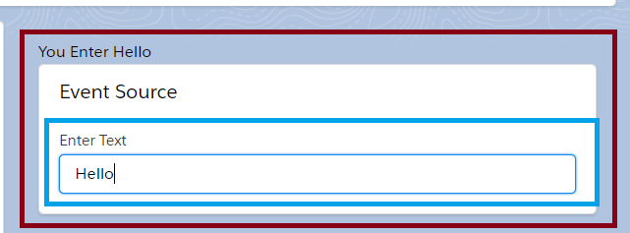
Example – Final Output
Create and dispatch events
Now if you see in the below image it shows the enter input data from the text box to container component. If you enter the text in the event source component, the CustomEvent will be fired and the same event details will be received at container component.
Notes:
ASG – Would need to be ready by Juen for the certified to sell – 3 mo in certified to sell. To show it off at dreamforce 2019.
App exchange I splanned for the solution. If it’s just an asset then they want to review our architecture.
We don’t’ want this on the app exchange.
Approval is all of us, Chandu,. He delegated Subhojit to be our architect.
LWC v Aura – need to be able to regenerate the components with a future technology if needed. Kiran, is the look and feel different, how would that be done?
Security is not yet future proof
Vivek – security team – AERS design
Could we add Louisiana in the mix, to design not to break it in the future – master mapping exercise in the govCONNECT model – if you’re a state with x, here is how you would map to our roles
Let’s make conscious decisions together.
CO – you configure the call, and ti calls an interface, and the framework handles how to call the interface and the elments that are prepopulated.

Slide 12
Handle Events

Slide 13
Handle Events
Handle events
Declaratively from the component’s HTML template.
Programmatically using an imperative JavaScript API.
It’s better to listen from the HTML template since it reduces the amount of code you need to write.
To handle events, define methods in the component’s JavaScript class.
The framework takes care of managing and cleaning up all of the listeners for you, as part of the component lifecycle, so you don’t have to worry about it.
However, if you add a listener to the global window object, you’re responsible for removing the listener yourself within the appropriate lifecycle hook. In this case,
Use the connectedCallback and disconnectedCallback methods to add and remove the event listeners.
Notes:
ASG – Would need to be ready by Juen for the certified to sell – 3 mo in certified to sell. To show it off at dreamforce 2019.
App exchange I splanned for the solution. If it’s just an asset then they want to review our architecture.
We don’t’ want this on the app exchange.
Approval is all of us, Chandu,. He delegated Subhojit to be our architect.
LWC v Aura – need to be able to regenerate the components with a future technology if needed. Kiran, is the look and feel different, how would that be done?
Security is not yet future proof
Vivek – security team – AERS design
Could we add Louisiana in the mix, to design not to break it in the future – master mapping exercise in the govCONNECT model – if you’re a state with x, here is how you would map to our roles
Let’s make conscious decisions together.
CO – you configure the call, and ti calls an interface, and the framework handles how to call the interface and the elments that are prepopulated.

Slide 14
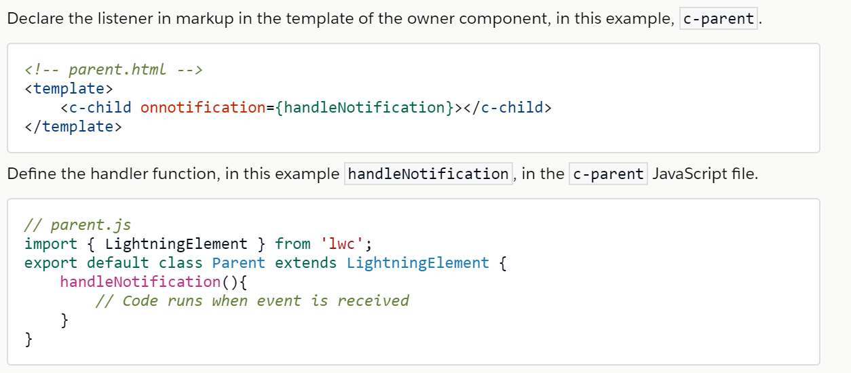
Example - Attach an Event Listener Declaratively
Handle events
Notes:
ASG – Would need to be ready by Juen for the certified to sell – 3 mo in certified to sell. To show it off at dreamforce 2019.
App exchange I splanned for the solution. If it’s just an asset then they want to review our architecture.
We don’t’ want this on the app exchange.
Approval is all of us, Chandu,. He delegated Subhojit to be our architect.
LWC v Aura – need to be able to regenerate the components with a future technology if needed. Kiran, is the look and feel different, how would that be done?
Security is not yet future proof
Vivek – security team – AERS design
Could we add Louisiana in the mix, to design not to break it in the future – master mapping exercise in the govCONNECT model – if you’re a state with x, here is how you would map to our roles
Let’s make conscious decisions together.
CO – you configure the call, and ti calls an interface, and the framework handles how to call the interface and the elments that are prepopulated.

Slide 15
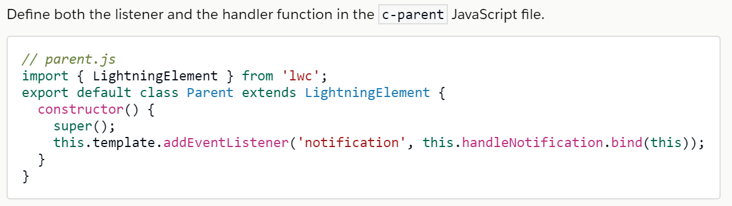
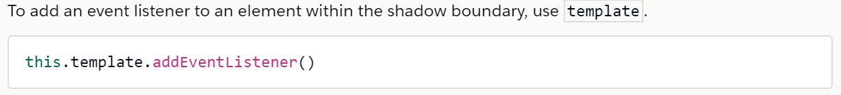
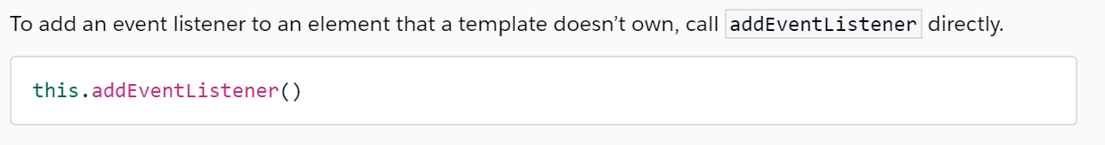
Example - Attach an Event Listener Programmatically
Handle events
Notes:
ASG – Would need to be ready by Juen for the certified to sell – 3 mo in certified to sell. To show it off at dreamforce 2019.
App exchange I splanned for the solution. If it’s just an asset then they want to review our architecture.
We don’t’ want this on the app exchange.
Approval is all of us, Chandu,. He delegated Subhojit to be our architect.
LWC v Aura – need to be able to regenerate the components with a future technology if needed. Kiran, is the look and feel different, how would that be done?
Security is not yet future proof
Vivek – security team – AERS design
Could we add Louisiana in the mix, to design not to break it in the future – master mapping exercise in the govCONNECT model – if you’re a state with x, here is how you would map to our roles
Let’s make conscious decisions together.
CO – you configure the call, and ti calls an interface, and the framework handles how to call the interface and the elments that are prepopulated.

Slide 16
Configure Event Propagation

Slide 17
Configure Event Propagation
Configure event propagation
The propagation of an event in LWC is controlled using two Boolean attributes, Bubbles and Composed.
Bubbles – Decides whether the event bubbles goes up through the DOM or not.
Composed - Decides whether the event can pass through the shadow boundary.
By default these attributes are set to false meaning - Bubbles : False, Composed : False
Only the component dispatching the event can handle it and need to add the listener on the component itself – Paginator Component
Bubbles : True, Composed : False - This event can be handled by the dispatching component as well as in the template containing this component. - EventBubbling Component
Bubbles : True, Compose : True – The event bubbles all the way to the document root. As it can be handled by all the templates in the hierarchy it may cause name collisions.
Notes:
ASG – Would need to be ready by Juen for the certified to sell – 3 mo in certified to sell. To show it off at dreamforce 2019.
App exchange I splanned for the solution. If it’s just an asset then they want to review our architecture.
We don’t’ want this on the app exchange.
Approval is all of us, Chandu,. He delegated Subhojit to be our architect.
LWC v Aura – need to be able to regenerate the components with a future technology if needed. Kiran, is the look and feel different, how would that be done?
Security is not yet future proof
Vivek – security team – AERS design
Could we add Louisiana in the mix, to design not to break it in the future – master mapping exercise in the govCONNECT model – if you’re a state with x, here is how you would map to our roles
Let’s make conscious decisions together.
CO – you configure the call, and ti calls an interface, and the framework handles how to call the interface and the elments that are prepopulated.

Slide 18
Configure Event Propagation
Configure event propagation
There are two ways to bubble up an event:
Bubble an event up inside the component’s template. This technique creates an internal event.
Bubble an event up inside the containing component’s template.
Best Practice - To name this kind of event one should include the domain or the component name to identify where its created from for eg : mydomain__myevent , listener - onmydomain__myevent , should be globally unique.
Bubbles : False, Composed : True – Not used in LWC.
Notes:
ASG – Would need to be ready by Juen for the certified to sell – 3 mo in certified to sell. To show it off at dreamforce 2019.
App exchange I splanned for the solution. If it’s just an asset then they want to review our architecture.
We don’t’ want this on the app exchange.
Approval is all of us, Chandu,. He delegated Subhojit to be our architect.
LWC v Aura – need to be able to regenerate the components with a future technology if needed. Kiran, is the look and feel different, how would that be done?
Security is not yet future proof
Vivek – security team – AERS design
Could we add Louisiana in the mix, to design not to break it in the future – master mapping exercise in the govCONNECT model – if you’re a state with x, here is how you would map to our roles
Let’s make conscious decisions together.
CO – you configure the call, and ti calls an interface, and the framework handles how to call the interface and the elments that are prepopulated.

Slide 19
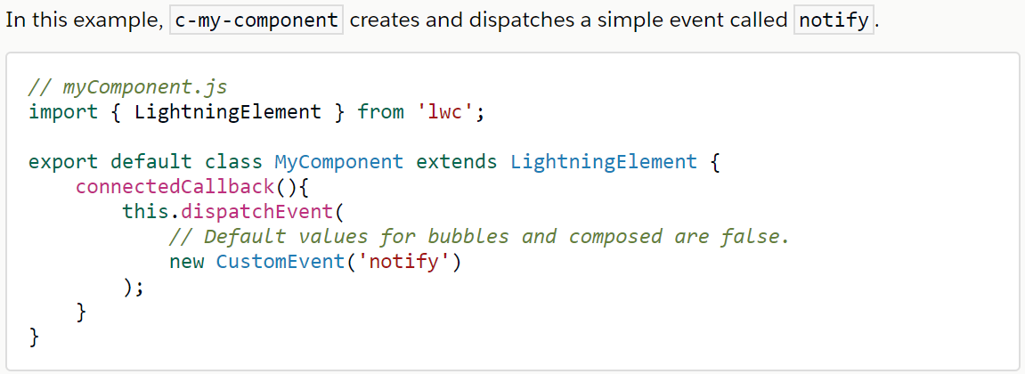
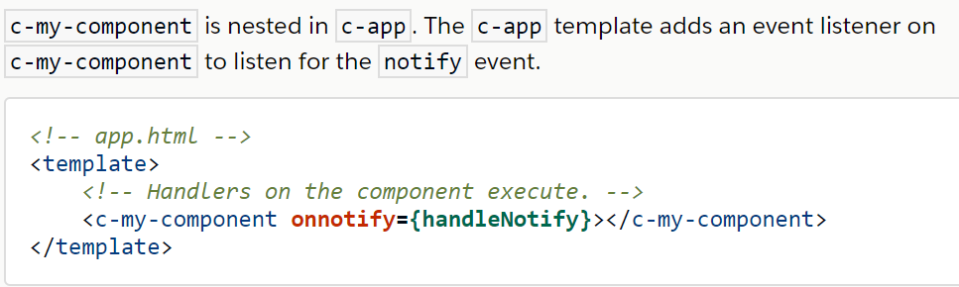
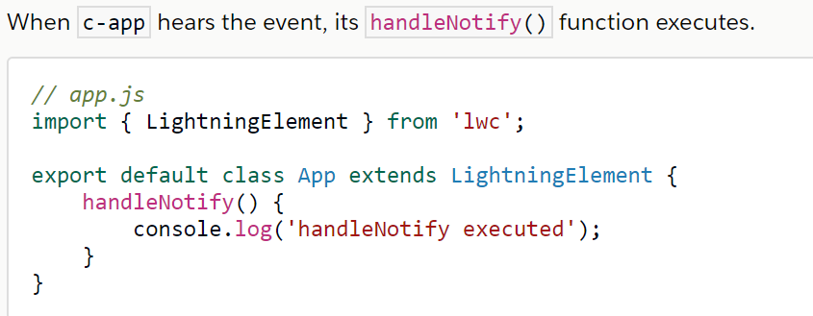
Example – bubbles: false & composed: false
Configure event propagation
Notes:
ASG – Would need to be ready by Juen for the certified to sell – 3 mo in certified to sell. To show it off at dreamforce 2019.
App exchange I splanned for the solution. If it’s just an asset then they want to review our architecture.
We don’t’ want this on the app exchange.
Approval is all of us, Chandu,. He delegated Subhojit to be our architect.
LWC v Aura – need to be able to regenerate the components with a future technology if needed. Kiran, is the look and feel different, how would that be done?
Security is not yet future proof
Vivek – security team – AERS design
Could we add Louisiana in the mix, to design not to break it in the future – master mapping exercise in the govCONNECT model – if you’re a state with x, here is how you would map to our roles
Let’s make conscious decisions together.
CO – you configure the call, and ti calls an interface, and the framework handles how to call the interface and the elments that are prepopulated.

Slide 20
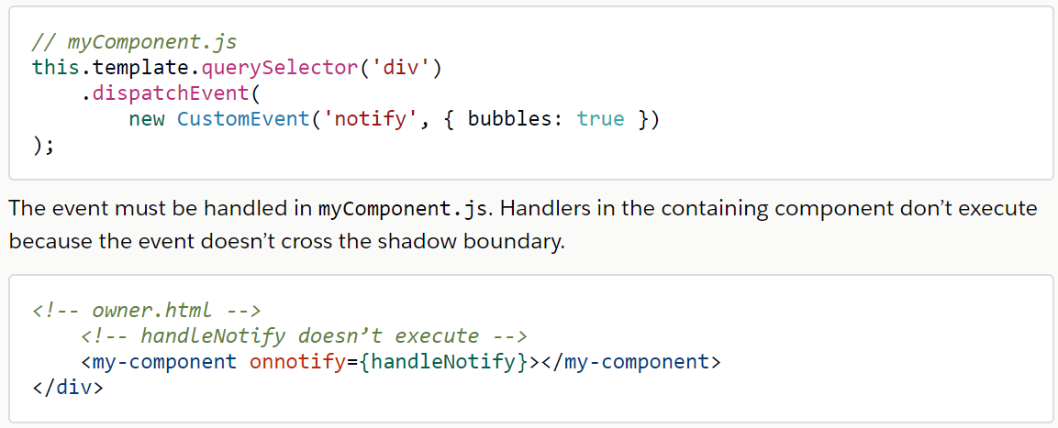
Example – bubbles: true & composed: false
Configure event propagation
Example 1
Notes:
ASG – Would need to be ready by Juen for the certified to sell – 3 mo in certified to sell. To show it off at dreamforce 2019.
App exchange I splanned for the solution. If it’s just an asset then they want to review our architecture.
We don’t’ want this on the app exchange.
Approval is all of us, Chandu,. He delegated Subhojit to be our architect.
LWC v Aura – need to be able to regenerate the components with a future technology if needed. Kiran, is the look and feel different, how would that be done?
Security is not yet future proof
Vivek – security team – AERS design
Could we add Louisiana in the mix, to design not to break it in the future – master mapping exercise in the govCONNECT model – if you’re a state with x, here is how you would map to our roles
Let’s make conscious decisions together.
CO – you configure the call, and ti calls an interface, and the framework handles how to call the interface and the elments that are prepopulated.

Slide 21
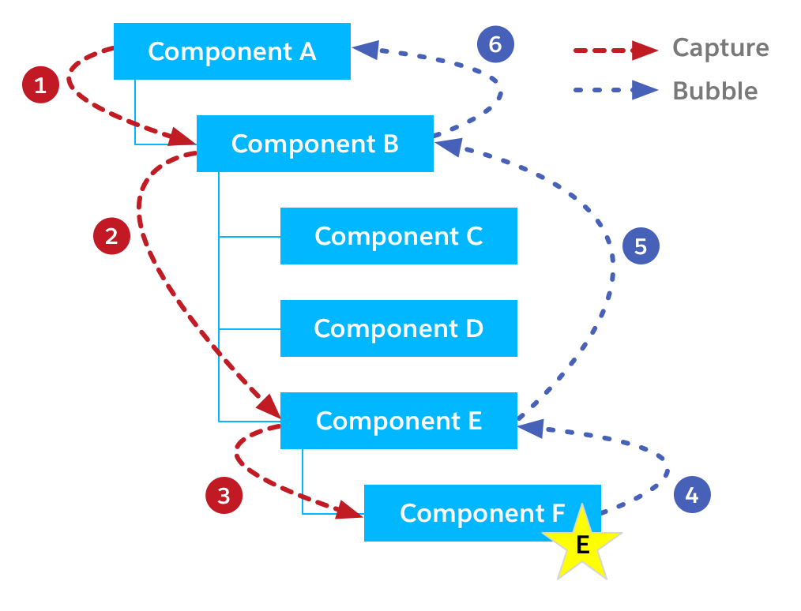
Event Propagation Phases
Configure event propagation
DOM Event Propagation Phases
Two consecutive propagation phases: capture (rarely used) and bubble (widely)
First, the event propagation doesn’t begin with Component F. The capture phase starts at the top of the DOM tree (1).
Second, the event doesn’t visit every node in the tree. Instead, it passes through only components that contain the component that originally fired the event.
In the diagram, Component C and Component D are left out, and can’t observe or act upon the event.
Notes:
ASG – Would need to be ready by Juen for the certified to sell – 3 mo in certified to sell. To show it off at dreamforce 2019.
App exchange I splanned for the solution. If it’s just an asset then they want to review our architecture.
We don’t’ want this on the app exchange.
Approval is all of us, Chandu,. He delegated Subhojit to be our architect.
LWC v Aura – need to be able to regenerate the components with a future technology if needed. Kiran, is the look and feel different, how would that be done?
Security is not yet future proof
Vivek – security team – AERS design
Could we add Louisiana in the mix, to design not to break it in the future – master mapping exercise in the govCONNECT model – if you’re a state with x, here is how you would map to our roles
Let’s make conscious decisions together.
CO – you configure the call, and ti calls an interface, and the framework handles how to call the interface and the elments that are prepopulated.

Slide 22
Communication Between Components

Slide 23
Communication Between Components
Communication between components
To communicate between components that aren’t in the same DOM tree, use a singleton library that follows the publish-subscribe pattern.
One component publishes an event. Other components subscribe to receive and handle the event. Every component that subscribes to the event receives the event.
For example, if you add two components to a Lightning page in Lightning App Builder, use the pubsub module to send events between them.
Notes:
ASG – Would need to be ready by Juen for the certified to sell – 3 mo in certified to sell. To show it off at dreamforce 2019.
App exchange I splanned for the solution. If it’s just an asset then they want to review our architecture.
We don’t’ want this on the app exchange.
Approval is all of us, Chandu,. He delegated Subhojit to be our architect.
LWC v Aura – need to be able to regenerate the components with a future technology if needed. Kiran, is the look and feel different, how would that be done?
Security is not yet future proof
Vivek – security team – AERS design
Could we add Louisiana in the mix, to design not to break it in the future – master mapping exercise in the govCONNECT model – if you’re a state with x, here is how you would map to our roles
Let’s make conscious decisions together.
CO – you configure the call, and ti calls an interface, and the framework handles how to call the interface and the elments that are prepopulated.

Slide 24
Event Best Practices

Slide 25
Event Best Practices
Event best practices
Use primitive data types to pass the value through event.
Don’t include the non-primitive from @api or @wire in detail. These values are wrapped in a read-only membrane.
In IE 11, when crossing the LWC to Aura bridge, the read-only membrane is lost, which means that mutation can occur.
bubbles : false, composed : true config is not recommended because they bubble up the entire DOM tree, across Shadow DOMs, and through parent components (unless stopped).
Notes:
ASG – Would need to be ready by Juen for the certified to sell – 3 mo in certified to sell. To show it off at dreamforce 2019.
App exchange I splanned for the solution. If it’s just an asset then they want to review our architecture.
We don’t’ want this on the app exchange.
Approval is all of us, Chandu,. He delegated Subhojit to be our architect.
LWC v Aura – need to be able to regenerate the components with a future technology if needed. Kiran, is the look and feel different, how would that be done?
Security is not yet future proof
Vivek – security team – AERS design
Could we add Louisiana in the mix, to design not to break it in the future – master mapping exercise in the govCONNECT model – if you’re a state with x, here is how you would map to our roles
Let’s make conscious decisions together.
CO – you configure the call, and ti calls an interface, and the framework handles how to call the interface and the elments that are prepopulated.

Slide 26
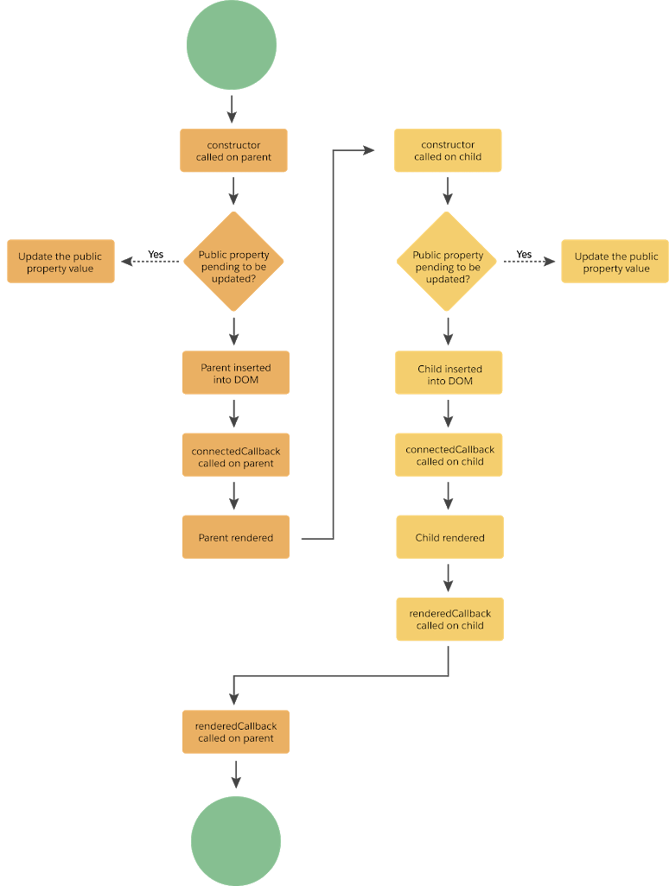
Lifecycle Hooks
Event best practices
constructor()
Called when the component is created.
connectedCallback()
Called when the element is inserted into a document.
disconnectedCallback()
Called when the element is removed from a document. This hook flows from parent to child.
render()
For complex tasks like conditionally rendering a template
renderedCallback()
Called after every render of the component.
errorCallback(error, stack)
Called when a descendant component throws an error in one of its lifecycle hooks.
Notes:
ASG – Would need to be ready by Juen for the certified to sell – 3 mo in certified to sell. To show it off at dreamforce 2019.
App exchange I splanned for the solution. If it’s just an asset then they want to review our architecture.
We don’t’ want this on the app exchange.
Approval is all of us, Chandu,. He delegated Subhojit to be our architect.
LWC v Aura – need to be able to regenerate the components with a future technology if needed. Kiran, is the look and feel different, how would that be done?
Security is not yet future proof
Vivek – security team – AERS design
Could we add Louisiana in the mix, to design not to break it in the future – master mapping exercise in the govCONNECT model – if you’re a state with x, here is how you would map to our roles
Let’s make conscious decisions together.
CO – you configure the call, and ti calls an interface, and the framework handles how to call the interface and the elments that are prepopulated.

Slide 27
Hands On Challenge

Slide 28
Compare Quotes
Hands On challenge
Use Case
Create a “OpportunitySearch” Lightning Web Component with a Search Filed which looks for Opportunities in the System.
Create a “QuoteComparator” Lightning Web Component which takes input as Opportunity Id from OpportunitySearch page and displays all the related quotes with a checkbox from the selected Opportunity. The User is allowed to select only two quotes. “Compare Line Items” button should be placed on the right top corner
Create a “QuoteLineItemDetails” Lightning web components which should take input as quote Id from “QuoteCopmparator” and display all the line items of each selected quote
Deploy the components and Create a Application Page in the App Builder with “header & Two Regions” and add the “OpporutnitySearch” and “QuoteCopartor” in Header and “QuoteLineItemDetails” in both the regions.
Note:
First region should display quote line items from first selected Quote and Second region should display Quote Line Item from Second Selected Quote.
Make use of events to pass the parameters from one component to other.
Notes:
ASG – Would need to be ready by Juen for the certified to sell – 3 mo in certified to sell. To show it off at dreamforce 2019.
App exchange I splanned for the solution. If it’s just an asset then they want to review our architecture.
We don’t’ want this on the app exchange.
Approval is all of us, Chandu,. He delegated Subhojit to be our architect.
LWC v Aura – need to be able to regenerate the components with a future technology if needed. Kiran, is the look and feel different, how would that be done?
Security is not yet future proof
Vivek – security team – AERS design
Could we add Louisiana in the mix, to design not to break it in the future – master mapping exercise in the govCONNECT model – if you’re a state with x, here is how you would map to our roles
Let’s make conscious decisions together.
CO – you configure the call, and ti calls an interface, and the framework handles how to call the interface and the elments that are prepopulated.

Slide 29
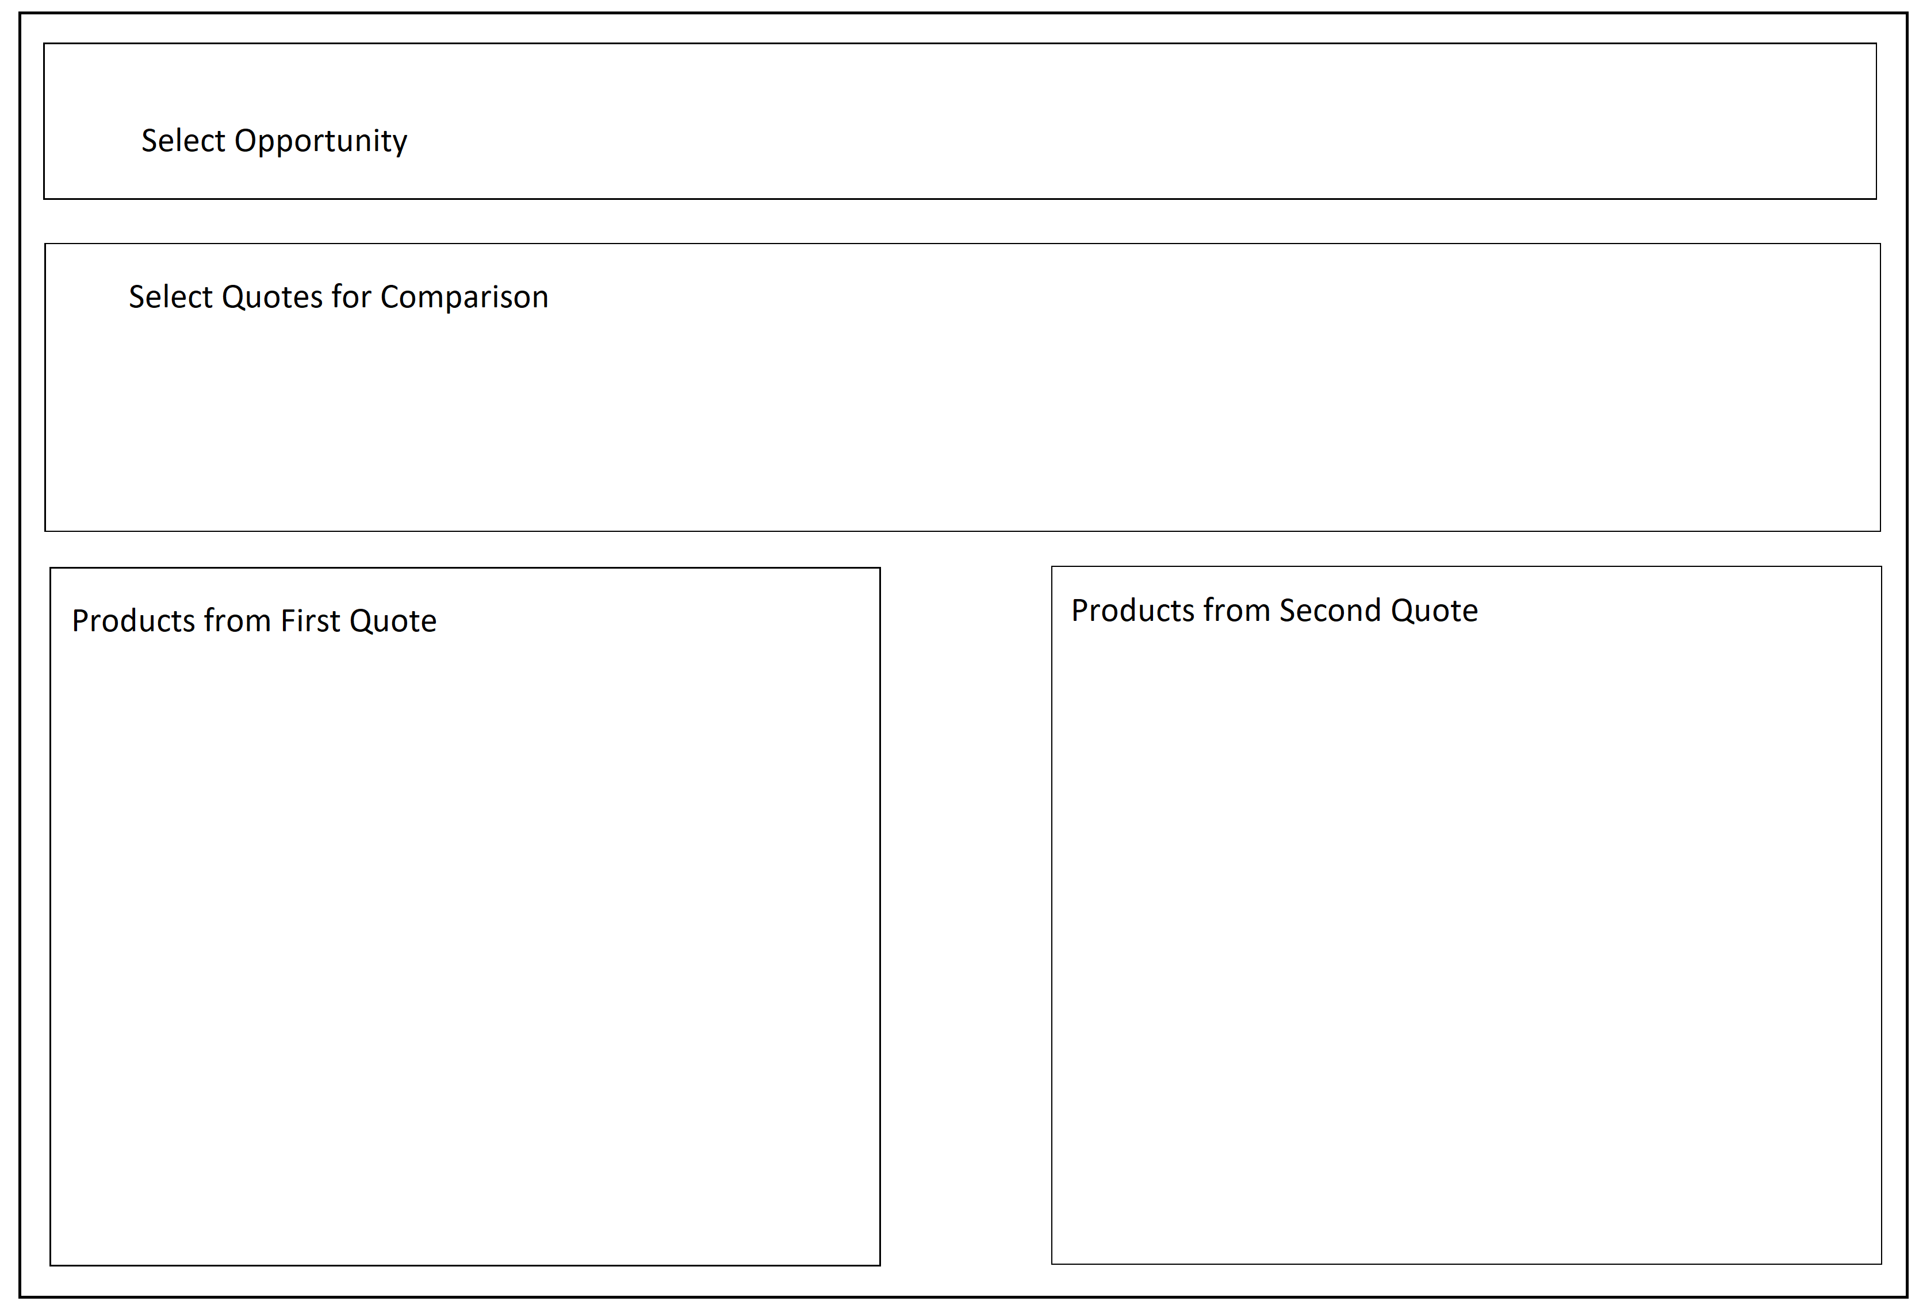
Quote Comparison (Contd.)
Hands On challenge
Notes:
ASG – Would need to be ready by Juen for the certified to sell – 3 mo in certified to sell. To show it off at dreamforce 2019.
App exchange I splanned for the solution. If it’s just an asset then they want to review our architecture.
We don’t’ want this on the app exchange.
Approval is all of us, Chandu,. He delegated Subhojit to be our architect.
LWC v Aura – need to be able to regenerate the components with a future technology if needed. Kiran, is the look and feel different, how would that be done?
Security is not yet future proof
Vivek – security team – AERS design
Could we add Louisiana in the mix, to design not to break it in the future – master mapping exercise in the govCONNECT model – if you’re a state with x, here is how you would map to our roles
Let’s make conscious decisions together.
CO – you configure the call, and ti calls an interface, and the framework handles how to call the interface and the elments that are prepopulated.

Slide 30
References
references
https://developer.salesforce.com/docs/component-library/documentation/lwc/events
https://trailhead.salesforce.com/content/learn/modules/lightning-web-components-for-aura-developers/communicate-with-events
Notes:
ASG – Would need to be ready by Juen for the certified to sell – 3 mo in certified to sell. To show it off at dreamforce 2019.
App exchange I splanned for the solution. If it’s just an asset then they want to review our architecture.
We don’t’ want this on the app exchange.
Approval is all of us, Chandu,. He delegated Subhojit to be our architect.
LWC v Aura – need to be able to regenerate the components with a future technology if needed. Kiran, is the look and feel different, how would that be done?
Security is not yet future proof
Vivek – security team – AERS design
Could we add Louisiana in the mix, to design not to break it in the future – master mapping exercise in the govCONNECT model – if you’re a state with x, here is how you would map to our roles
Let’s make conscious decisions together.
CO – you configure the call, and ti calls an interface, and the framework handles how to call the interface and the elments that are prepopulated.

Slide 31
Questions

Slide 32
1. Which interface is implemented by Lightning web components to dispatch events, listen for events, and handle events?
CustomEvent
EventTarget
DOM events
StandardEvent
2.what are the ways to listen for an event
Declaratively
Programmatically
Both
None
3. what all the recommended best practices when working with events.
Use primitive data types to pass the value through event.
include the non-primitive from @api or @wire in detail. These values are wrapped in a read-only membrane.
bubbles : True, composed : True config is not recommended because they bubble up the entire DOM tree, across Shadow DOMs, and through parent components (unless stopped).
All of the above
4. how propagation of an event in LWC is controlled
Bubbles
Composed
Both a and b
Non of the above
Notes:
ASG – Would need to be ready by Juen for the certified to sell – 3 mo in certified to sell. To show it off at dreamforce 2019.
App exchange I splanned for the solution. If it’s just an asset then they want to review our architecture.
We don’t’ want this on the app exchange.
Approval is all of us, Chandu,. He delegated Subhojit to be our architect.
LWC v Aura – need to be able to regenerate the components with a future technology if needed. Kiran, is the look and feel different, how would that be done?
Security is not yet future proof
Vivek – security team – AERS design
Could we add Louisiana in the mix, to design not to break it in the future – master mapping exercise in the govCONNECT model – if you’re a state with x, here is how you would map to our roles
Let’s make conscious decisions together.
CO – you configure the call, and ti calls an interface, and the framework handles how to call the interface and the elments that are prepopulated.

